Slide 1
Entity id, level, name, iso_code
Core data
Meta_indicator_data id, p_name, family, num_type, provider, P_description
1 to m relation Select * from point where entid=id and year=year
1 to m relation Select name from point where indid=indid
Literal_indicator_data ent_id, year, value, dispay_name**, meta_id,
Strengths – a simple to understand db minimizing redundancy. display_name is a composite string of indicator name and source name (both may be shortened for easy display).

Slide 2
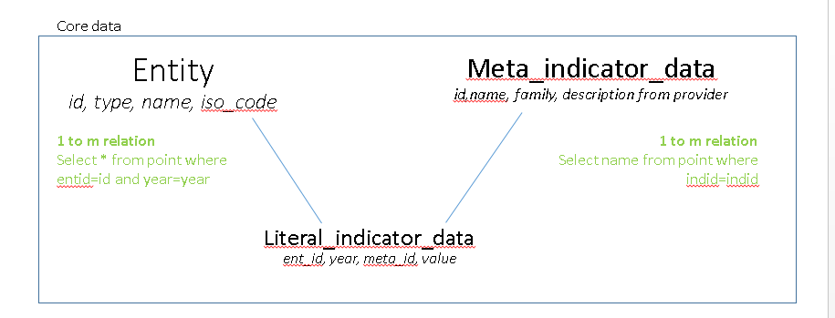
Saved_data_sets ID, date created, comments, tags

